Slide 1
Incidence of Clinical Suicidal Ideation and its Clinical Predictors
Kevin Diaz and Shanyah Mitchell
Hanga Galfalvy, PhD
Departments of Psychiatry and Biostatistics

Slide 2
Background/Introduction
Suicidal ideation - thoughts about killing oneself.
Appears in 4% of adults in the United States.
Among those who ideate, probability of a suicide without a plan is 15% and shoots up to 55% for having a history of ideation.
Our Aim
To examine high suicide risk by identifying the factors that are associated with high suicidal ideation.
In our study, the level of suicidal ideation is measured in two variables.
Current ideation
Worst ideation

Slide 3
Data and Methods
Data Collection
Total Cross Sectional sample were recruited from:
psychogeriatric inpatient units.
a late-life depression clinic.
primary care community advertisements.
The O’Carrol definition for suicide attempt was followed (self-injurious act undertaken with intent to die.)
Baseline and longitudinal datasets were merged then data was filtered to contain only values stemming from the baseline.
Approach
Analysis based on hypothesis testing.
Followed by data mining procedures to explore associations not included in the hypothesis.

Slide 4
Subjects and Scales
Subjects: Members in all groups are depressed according to their Hamilton depression rating scores.
Depressed (n=100) - Depressed participants who do not ideate.
Ideator (n=90) - Depressed participants who ideate, but do not have a history of suicide attempts.
Attempters (n=153) - Depressed participants who have previous history of suicide attempts, they may or may not be currently ideating.
Psychiatric scales:
Scale of Suicidal Ideation (SSI) - measures suicidal ideation in an individual (higher scores = worse).
Hamilton Depression Rating Scale (HDRS)- used to assess depression in an individual (higher scores = worse).
Mini Mental Status Exam (MMSE) - used to test cognitive function (lower scores = worse).
Interpersonal Support Evaluation List (ISEL) - measures perceived self esteem and belongingness in an individual (lower scores = worse).

Slide 5
Hypothesis
We wanted to examine how certain variables affected the suicidal ideation overall and between different groups.
Hamilton Depression Rating Scale
Mini Mental Status Exam
ISEL Self Esteem
ISEL Belonging
Do the participants who ideate have different scores than those who do not ideate?
How does the variable affect the individuals ideation?

Slide 6
Statistical Methods
Data Management
Merged two datasets into cross sectional study using only Baseline variables (visits = 0).
Response variables (SSI Current and SSI Worst) were graphed by group.
Removed categorical variables.
Hypothesis Test:
A T- test and a ANOVA test of our hypothesized variables was performed on two different groupings of the participants, respectively (α=0.05).
Non-Ideators vs Ideators
Attemptors vs Depressed vs Ideators
Correlational analysis on the severity of ideation was performed on all hypothesized variables.
Logistic regression analysis with current ideation (yes/no as response variable).
Independent variables hypothesized , with Gender, and Age as covariates.
.

Slide 7
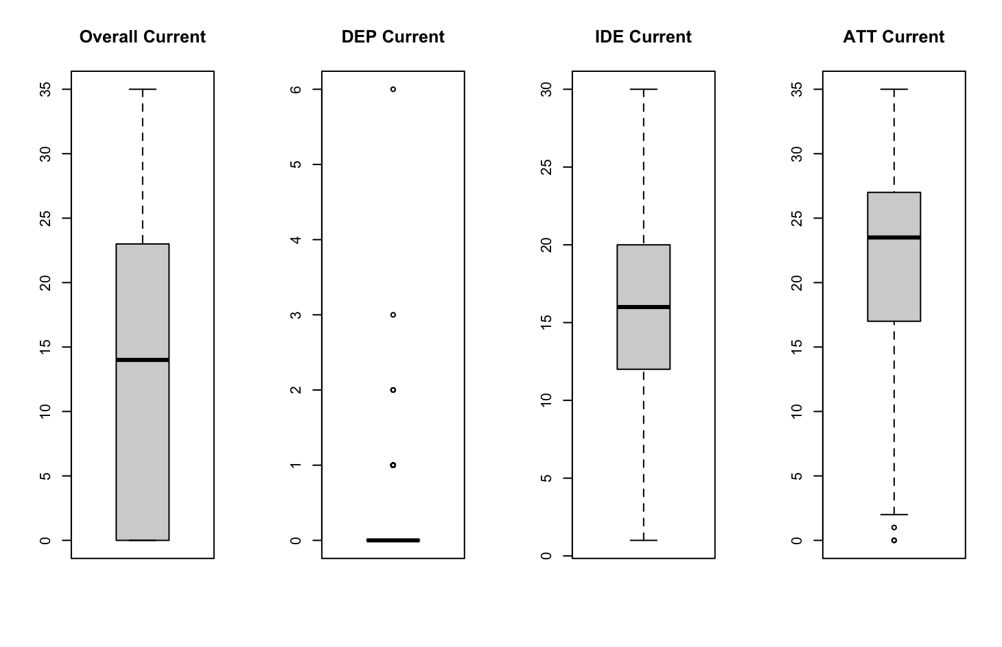
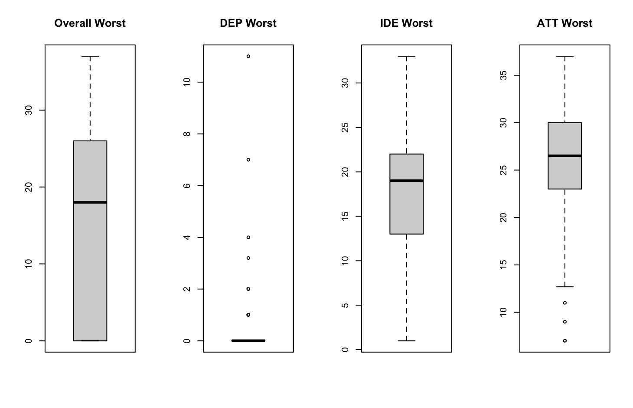
Distribution of SSI scores overall and by group

Slide 8
Results
Current Ideation (SSI) | Non-Ideators | Ideators | p-value |  | Depressed | Ideators | Attempters | p-value
Hamilton Depression Rating Scale | 18.08 | 22.61 | <0.01 |  | 18.20 | 22.10 | 22.93 | <0.01
Mini Mental Status Exam | 28.49 | 27.89 | 0.02 |  | 28.40 | 28.30 | 27.62 | <0.01
ISEL Belonging | 3.08 | 3.10 | <0.01 |  | 2.94 | 3.37 | 2.99 | <0.01
ISEL Self Esteem | 6.43 | 5.00 | <0.01 |  | 6.55 | 5.20 | 4.77 | <0.01
Hamilton Depression Rating Scale- used to assess depression in an individual, and its severity
Mini Mental Status Exam - measures an individual’s cognitive function
ISEL
Belonging- measure how much an individual feels they belong
Self Esteem- measures an individual's self esteem
Notes:
between the ide att groups there was no significant difference except in the mini mental score with .03 but some scores where not present in ever participant
*Based on current ideation (put at the top) current ideation comparison.
some of the subjects in the attempter group are also in the non ideator group
use the same number of decimal places.
Missing statistical methods section.
groups were compared on psychiatric scales using t test for group comparison and analysis of variances for groups.

Slide 9
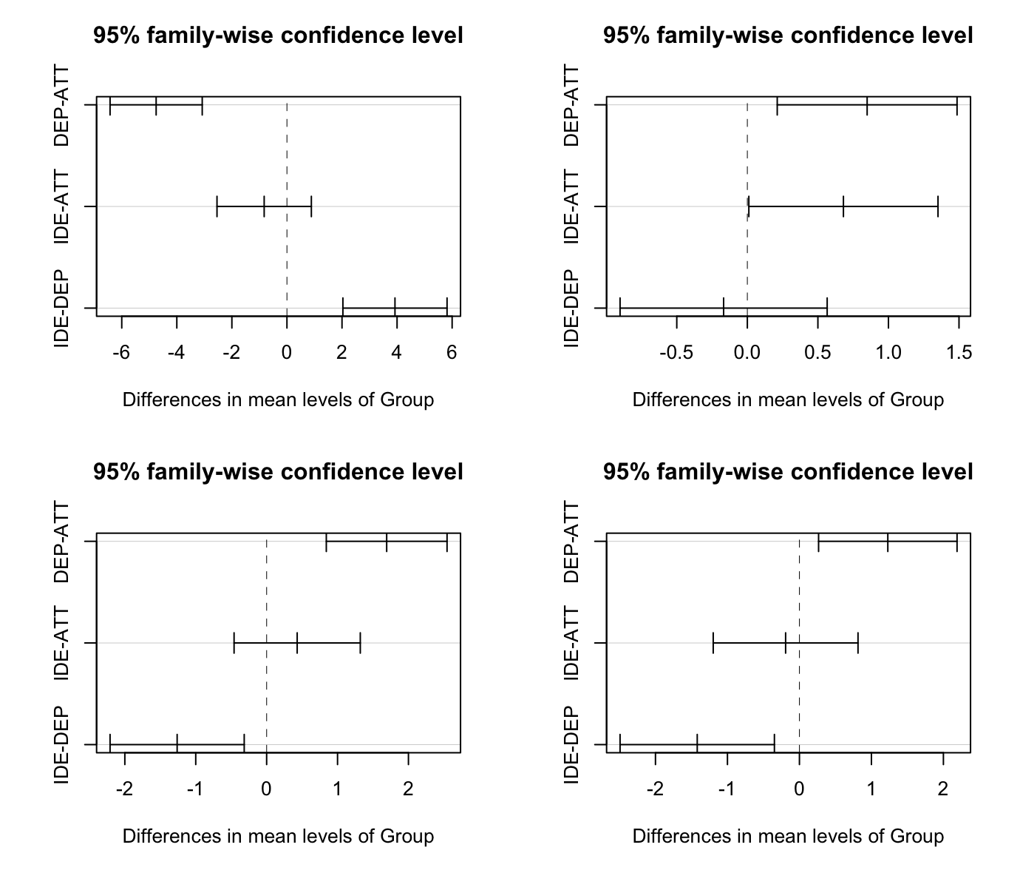
Results
Pairwise comparisons
Top:
Hamilton Depression Rating Scale
Mini mental status exam
Bottom:
ISEL Self esteem
ISEL Belonging
Notes:
Hamilton Depression Rating
Mini mental
ISEL Self esteem
ISEL Belonging
*further analysis
exp function with coefficient gives odds ratio for 1 point increase so its close to one every increa

Slide 10
Results
Logistic Regression
Predictors: HDRS, MMSE, Self Esteem, Belonging
Response: Presence of Ideation
What indicates a person is more likely to ideate?
A higher score on the Hamilton Depression Rating scale.
A lower score on:
Mini mental status exam
ISEL self esteem scale
ISELl belonging scale
Predictor Variables | Coefficient | p-value
Hamilton Depression Rating Scale (HDRS) | 0.156 | <0.001
Mini Mental Status Exam (MMSE) | -0.221 | <0.001
Self Esteem | -0.183 | <0.001
Belonging | -0.131 | <0.001

Slide 11
Data Mining Outline (1 of 2)
Reasoning
The 4 variables in the hypothesis based approach were assumed to have an effect at the start of the study.
The Data Mining approach examines the complete set of psychometric measures to determine missed risk factors in the original hypothesis.
Several measures are highly correlated with each other, this is addressed by our Lasso model.
Bivariate Analysis
Conducted Bivariate analysis using sapply for Spearman correlations and P-values on 54 variables calculated with SSI current and SSI worst.

Slide 12
Data Mining Outline (2 of 2)
Preparation
Missing values calculated using multiple imputation with chained equations (mice.
Predictors were scaled, response was binary (SSI current > 0).
Lasso logistic regression
We decided that we wanted to use lasso regression to examine whether this method would result in similar predictors to our variables of interest (and because lasso regression works with correlated predictors.)
Performed K-fold cross validation using cv.glmnet to calculate tuning parameter lambda.
Conducted lasso regression using glmnet.

Slide 13
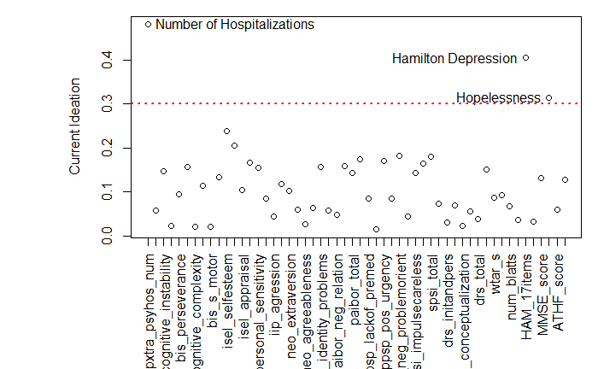
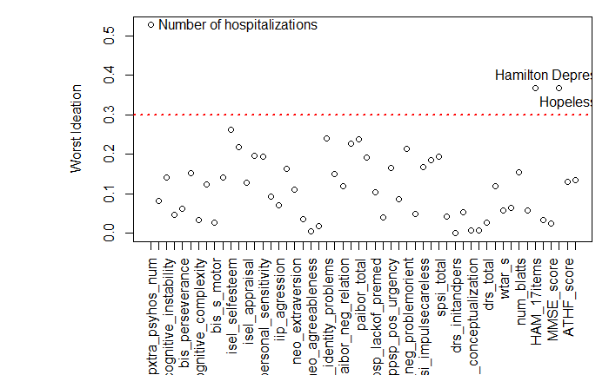
Bivariate Analysis Results
Current Ideation Predictors based on absolute value Spearman Correlation coefficients and high significance.
Worst Ideation Predictors based on absolute value Spearman Correlation coefficients and high significance.

Slide 14
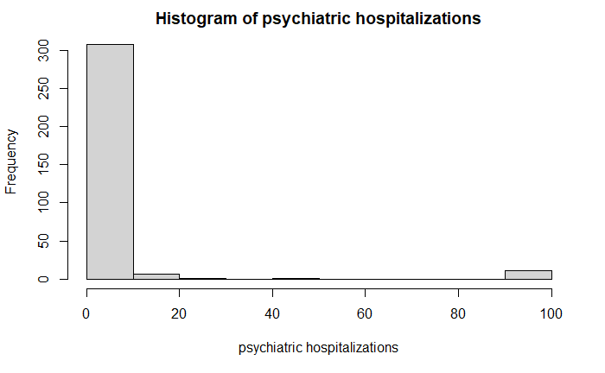
Significant Variables with Large Effect Size
Hopelessness - A scale used to assess one’s negative expectations regarding the future.
Hamilton Depression - A scale used to assess depression in an individual.
Number of Hospitalizations - Count of the number of psychiatric hospitalizations.
“Capped” the variable at 20.
Heavily inflated with 0 values.
The value of 99 means too many hospitalizations to count.

Slide 15
LASSO feature selection
Coefficients:
(Intercept)
Hamilton Depression
Hopelessness
Number of Hospitalizations
Impassivity Positive Urgency
Cognitive Control
Negative Problem Orient
Identity Problems
Mini Mental Status Exam
Estimate
1.22156086
0.41305739
0.39888961
0.21476963
0.10447118
0.09124816
0.03832892
0.02308533
-0.07505232
Conducted as a lasso logistic regression on whether subject showed evidence of suicidal ideation or not.
Hamilton Depression, Hopelessness, and Number of Hospitalizations held the highest three coefficients.
Mini Mental Status Exam score holds a negative correlation with our response variables Current Ideation.
Variables highlight three domains of clinical psychology.
Depression Severity
Cognition
Personality

Slide 16
Conclusions
Hypothesis Approach
Non-Ideators differed from Ideators in all 4 scales.
Differences greatest between Depressed and Attempter participants.
The Hamilton Depression Rating Scale, Mini Mental Status Exam, ISEL Self Esteem and Isel Belonging could be used to indicate ideation.
Data Mining
The variables highlighted by the bivariate analysis aligned with the results of the hypothesis based approach:
Number of Hospitalizations
Hopelessness
Hamilton Depression
LASSO regression confirmed that these three predictors held high significance in predicting the presence of suicidal ideation as well as other potential risk factors.

Slide 17
Acknowledgements
Dr. Hanga Galfalvy
Justine Herrera
BEST program instructors

Slide 18
Reference
Szanto, K., Galfalvy, H., Kenneally, L., Almasi, R., & Dombrovski, A. Y. (2020, August 7). Predictors of serious suicidal behavior in late-life depression. European Neuropsychopharmacology. https://www.sciencedirect.com/science/article/pii/S0924977X20301905.
Draper, B., MacCuspie-Moore, C., & Brodaty, H. (1998, July 1). Suicidal ideation and the 'wish to die' in dementia patients: the role of depression. OUP Academic. https://academic.oup.com/ageing/article/27/4/503/32742?login=true.
Rowe, J. L., Conwell, Y., Schulberg, H. C., & Bruce, M. L. (2013, January 24). Social Support and Suicidal Ideation in Older Adults Using Home Healthcare Services. The American Journal of Geriatric Psychiatry. https://www.sciencedirect.com/science/article/pii/S1064748112607106.
Tool:&nbsp;Brummett, A. of. (n.d.). Measurement Instrument Database for the Social Sciences. Interpersonal Support Evaluation List (ISEL) | Measurement Instrument Database for the Social Sciences. https://www.midss.org/content/interpersonal-support-evaluation-list-isel.
UpToDate. (n.d.). https://www.uptodate.com/contents/suicidal-ideation-and-behavior-in-adults.
Notes:
-https://www.sciencedirect.com/science/article/pii/S0924977X20301905
Predictors of serious suicidal behavior in late-life depression
Katalin Szantoa,∗ , Hanga Galfalvy , Laura Kenneally, Rebeka Almasi, Alexandre Y Dombrovskia
potential references:
https://academic.oup.com/ageing/article/27/4/503/32742?login=true Suicidal ideation and the ‘wish to die’ in dementia patients: the role of depression
https://www.sciencedirect.com/science/article/pii/S1064748112607106 Social Support and Suicidal Ideation in Older Adults Using Home Healthcare Services

Slide 19
Any Questions?

